Slide 1
24EC2104 ELECTRONIC DEVICES & CIRCUIT DESIGN
SESSION - 3

Slide 2
24EC2104 ELECTRONIC DEVICES & CIRCUIT DESIGN
Session Flow:
Concept of amplification
transistors
Construction of bjt
Operation
Current components
Configurations
Characteristics of bjt
Cut-off, active and saturation regions

Slide 3
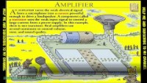
24EC2104 ELECTRONIC DEVICES & CIRCUIT DESIGN
https://www.youtube.com/watch?v=HtXieQa0IlU

Slide 4
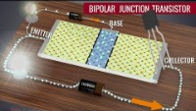
24EC2104 ELECTRONIC DEVICES & CIRCUIT DESIGN
https://www.youtube.com/watch?v=7ukDKVHnac4

Slide 5
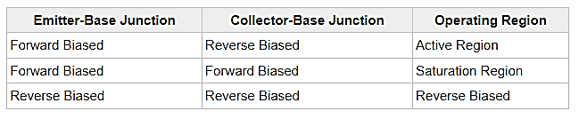
24EC2104 ELECTRONIC DEVICES & CIRCUIT DESIGN

Slide 6
24EC2104 ELECTRONIC DEVICES & CIRCUIT DESIGN
How to Increase V_{D}?
I_{D}
By increasing V
By increasing I_{D}
?
V_{D}
But V not to be increased.
V
By Increasing Q
?
Then How?

Slide 7
24EC2104 ELECTRONIC DEVICES & CIRCUIT DESIGN
I_{D}
V_{D}
V

Slide 8
24EC2104 ELECTRONIC DEVICES & CIRCUIT DESIGN
Emitter
Base
Collector
Heavily Doped
Moderate in Size
Moderately Doped
Large in Size
Lightly Doped
Small in Size

Slide 9
24EC2104 ELECTRONIC DEVICES & CIRCUIT DESIGN
Biasing:
Bias is direct current ( DC ) deliberately made to flow, or DC voltage deliberately applied, between two points for the purpose of controlling a circuit . In a bipolar transistor , the bias is usually specified as the direction in which DC from a battery or power supply flows between the emitter and the base.
Need for Biasing:
setting a transistors DC operating voltage or current conditions to the correct level so that any AC input signal can be amplified correctly by the transistor. ➢ To active an transistor, biasing is essential.
Fixed Bias
Collector to Base Bias
Self Bias
Types of Biasing:

Slide 10
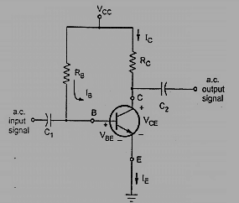
24EC2104 ELECTRONIC DEVICES & CIRCUIT DESIGN
Fixed Bias:
The circuit shown is called as a “fixed base bias circuit”, because the transistors base current, IB remains constant for given values of Vcc, and therefore the transistors operating point must also remain fixed. The collector current does not remain constant with variation in temperature or power supply voltage.

Slide 11
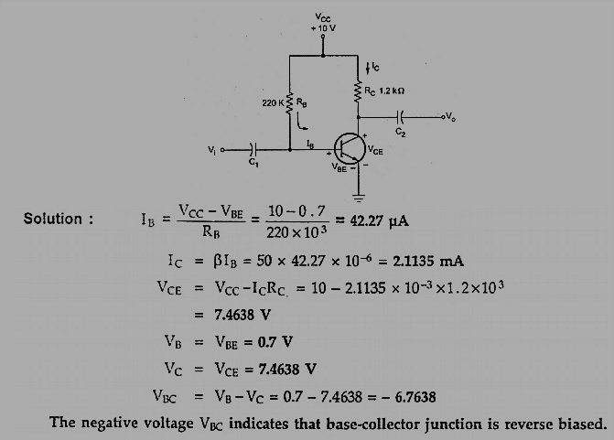
24EC2104 ELECTRONIC DEVICES & CIRCUIT DESIGN

Slide 12
24EC2104 ELECTRONIC DEVICES & CIRCUIT DESIGN
Uses of Fixed Bias:
Fixed Bias Circuit is often used in circuits where transistor is used as a switch. However, one application of fixed bias is to achieve crude automatic gain control in the transistor by feeding the base resistor from a DC signal derived from the AC output of a later stage. 1.

Slide 13
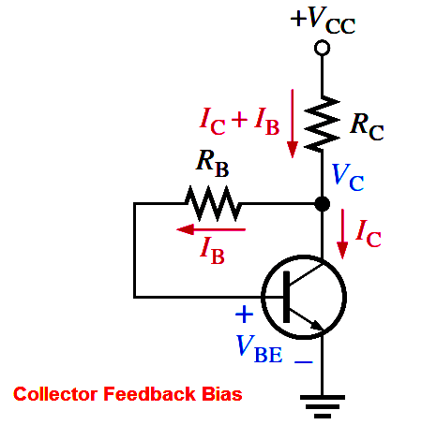
24EC2104 ELECTRONIC DEVICES & CIRCUIT DESIGN
Collector to Base Bias:
This circuit helps in improving the stability considerably. If the value of I_{C} increases, the voltage across R_{L} increases and hence the V_{CE} also increases. This in turn reduces the base current I_{B}. This action somewhat compensates the original increase.
The collector to base feedback configuration ensures that the transistor is always biased in the active region regardless of the value of Beta (β). The DC base bias voltage is derived from the collector voltage V_{C}, thus providing good stability.

Slide 14
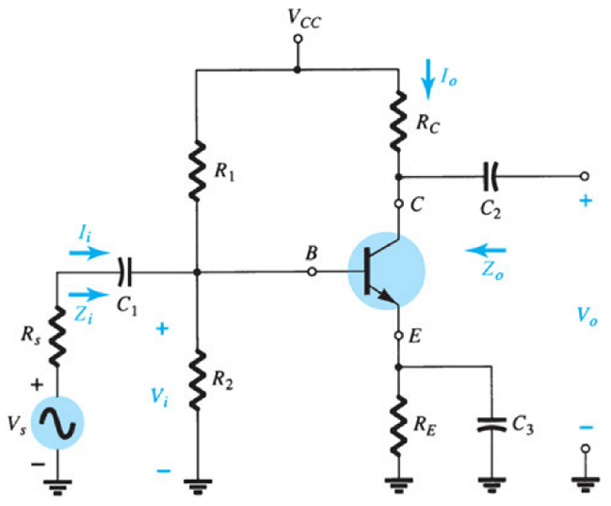
24EC2104 ELECTRONIC DEVICES & CIRCUIT DESIGN
Self Bias:
Self-Bias. A better method of biasing is obtained by inserting the bias resistor directly between the base and collector, as shown in figure below. By tying the collector to the base in this manner, feedback voltage can be fed from the collector to the base to develop forward bias. This arrangement is called SELF-BIAS.
This is also called the emitter follower for the same reason as the power supply follows the base bias and this stabilizes the Vbe. As the input changes or Vbb change, the power supply stabilization make the bias constant so that Vo remain constant and so self bias instead of external interference to stabilize out put.

Slide 15
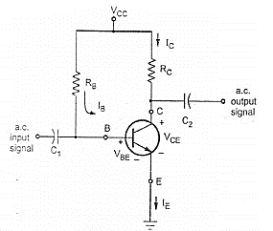
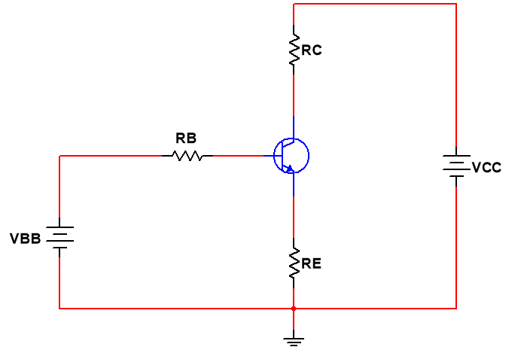
24EC2104 ELECTRONIC DEVICES & CIRCUIT DESIGN
Fixed Bias
Collector to Base Bias
Self Bias
By Applying Thevenin’s Theorem to the input circuit, All the three circuits reduce to a single circuit as shown.

Slide 16
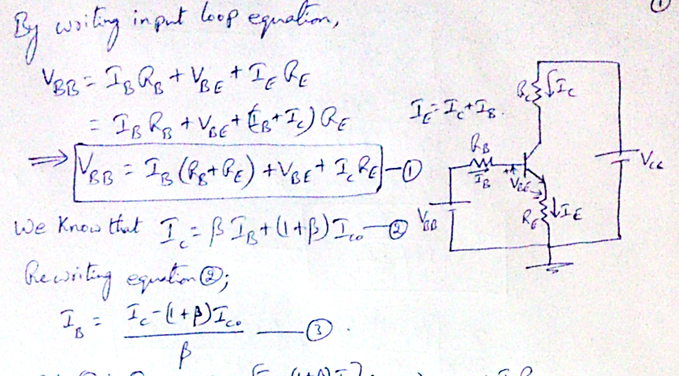
24EC2104 ELECTRONIC DEVICES & CIRCUIT DESIGN

Slide 17
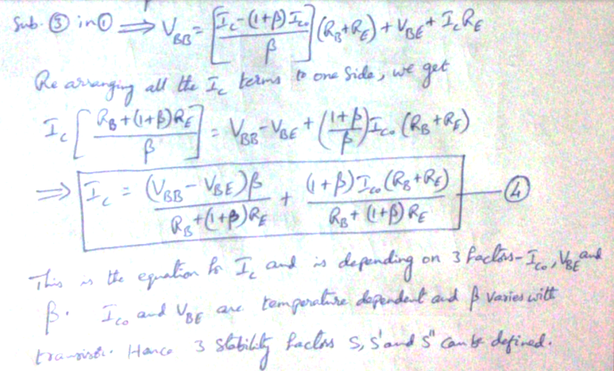
24EC2104 ELECTRONIC DEVICES & CIRCUIT DESIGN

Slide 18
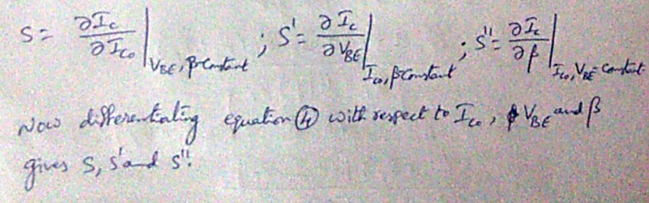
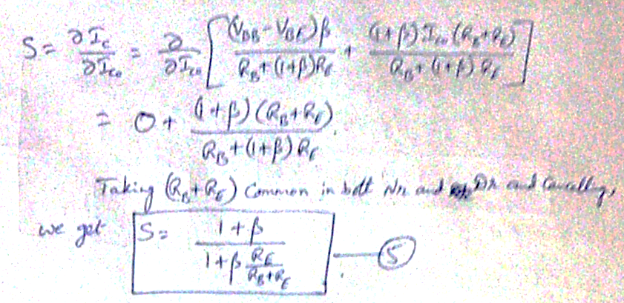
24EC2104 ELECTRONIC DEVICES & CIRCUIT DESIGN

Slide 19
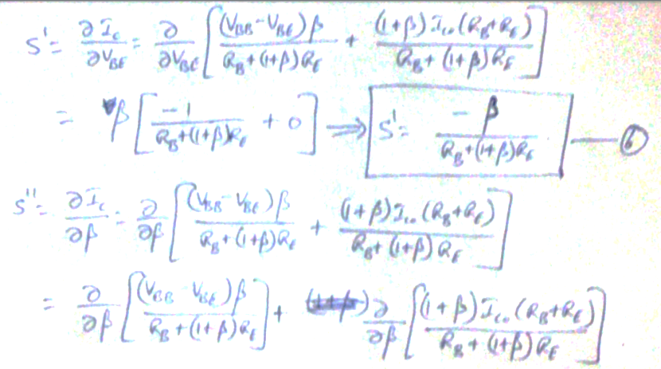
24EC2104 ELECTRONIC DEVICES & CIRCUIT DESIGN

Slide 20
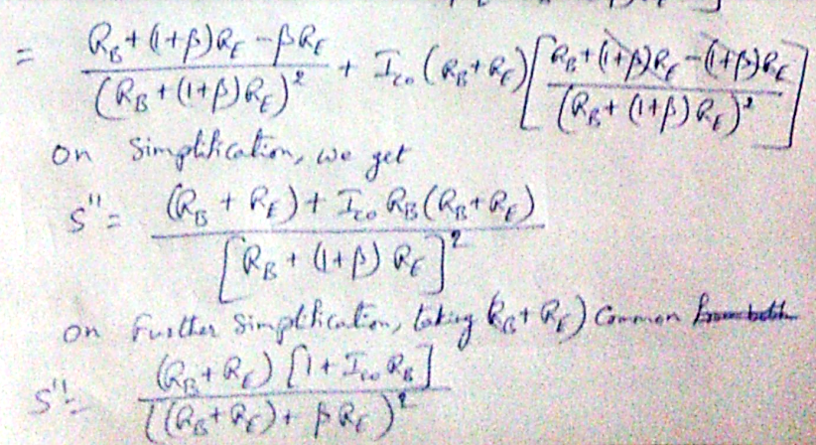
24EC2104 ELECTRONIC DEVICES & CIRCUIT DESIGN

Slide 21
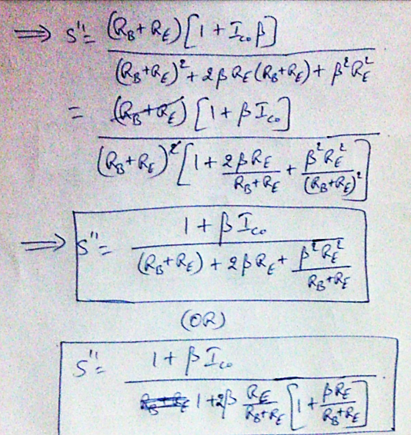
24EC2104 ELECTRONIC DEVICES & CIRCUIT DESIGN

Slide 22
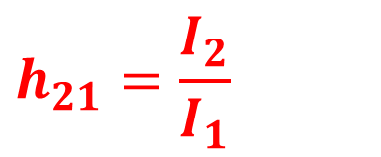
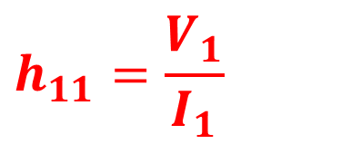
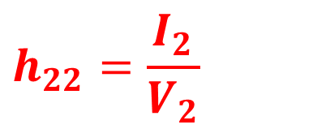
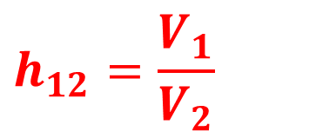
24EC2104 ELECTRONIC DEVICES & CIRCUIT DESIGN
h – Parameter Model:
$$h_{11}=\frac{V_{1}}{I_{1}}$$
V₂ = 0.
i.e., output
Short Circuit
I₁
I₂
1
Linear
Two Port Network
2
+
+
$$h_{12}=\frac{V_{1}}{V_{2}}$$
I₁ = 0.
i.e., input
Open Circuit
V₁
V₂
-
-
$$h_{21}=\frac{I_{2}}{I_{1}}$$
1’
V₂ = 0.
i.e., output
Short Circuit
2’
Dependent Variables:
V₁, I₂
V₁ = h₁₁ I₁ + h₁₂ V₂
I₂ = h₂₁ I₁ + h₂₂ V₂
$$h_{22}=\frac{I_{2}}{V_{2}}$$
I₁ = 0.
i.e., input
Open Circuit
Independent Variables:
I₁, V₂

Slide 23
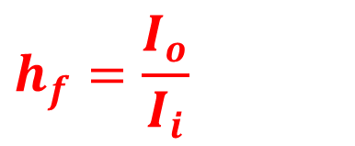
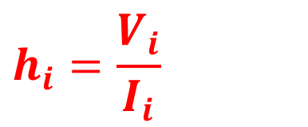
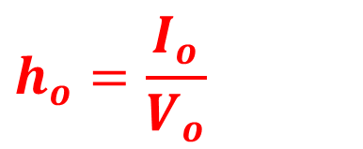
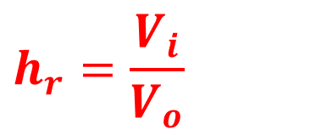
24EC2104 ELECTRONIC DEVICES & CIRCUIT DESIGN
h – Parameter Model for transistor:
$$h_{i}=\frac{V_{i}}{I_{i}}$$
V_{o} = 0.
i.e., output
Short Circuit
I_{i}
I_{o}
1
Transistor
2
+
+
$$h_{r}=\frac{V_{i}}{V_{o}}$$
I_{i} = 0.
i.e., input
Open Circuit
V_{i}
V_{o}
-
-
$$h_{f}=\frac{I_{o}}{I_{i}}$$
1’
V_{o} = 0.
i.e., output
Short Circuit
2’
Dependent Variables:
V_{i} , I_{o}
V_{i} = h_{i} I_{i} + h_{r} V_{o}
I_{o} = h_{f} I_{i} + h_{o} V_{o}
$$h_{o}=\frac{I_{o}}{V_{o}}$$
I_{i} = 0.
i.e., input
Open Circuit
Independent Variables:
I_{i} , V_{o}

Slide 24
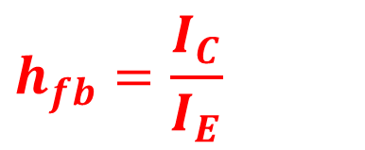
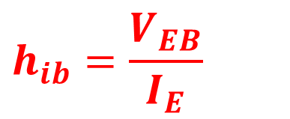
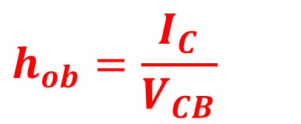
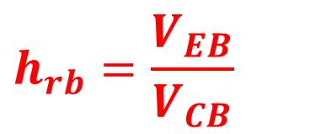
24EC2104 ELECTRONIC DEVICES & CIRCUIT DESIGN
h – Parameter Model for Common Base:
$$h_{ib}=\frac{V_{EB}}{I_{E}}$$
V_{CB} = 0.
i.e., output
Short Circuit
I_{E}
I_{C}
E
Transistor
C
+
+
$$h_{rb}=\frac{V_{EB}}{V_{CB}}$$
I_{E} = 0.
i.e., input
Open Circuit
V_{EB}
V_{CB}
-
-
$$h_{fb}=\frac{I_{C}}{I_{E}}$$
B
V_{CB} = 0.
i.e., output
Short Circuit
B
Dependent Variables:
V_{EB} , I_{C}
V_{EB} = h_{ib} I_{E} + h_{rb} V_{CB}
I_{C} = h_{fb} I_{E} + h_{ob} V_{CB}
$$h_{ob}=\frac{I_{C}}{V_{CB}}$$
I_{E} = 0.
i.e., input
Open Circuit
Independent Variables:
I_{E} , V_{CB}

Slide 25
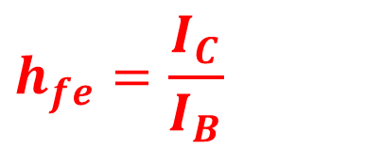
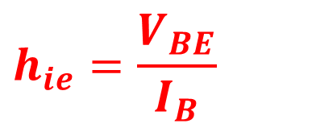
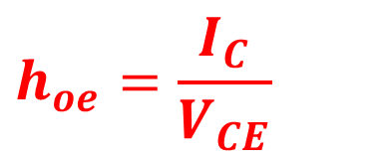
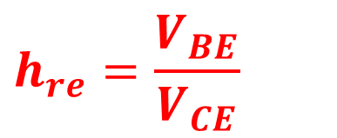
24EC2104 ELECTRONIC DEVICES & CIRCUIT DESIGN
h – Parameter Model for Common Emitter:
$$h_{ie}=\frac{V_{BE}}{I_{B}}$$
V_{CE} = 0.
i.e., output
Short Circuit
I_{B}
I_{C}
B
Transistor
C
+
+
$$h_{re}=\frac{V_{BE}}{V_{CE}}$$
I_{B} = 0.
i.e., input
Open Circuit
V_{BE}
V_{CE}
-
-
$$h_{fe}=\frac{I_{C}}{I_{B}}$$
E
V_{CE} = 0.
i.e., output
Short Circuit
E
Dependent Variables:
V_{BE} , I_{C}
V_{BE} = h_{ie} I_{B} + h_{re} V_{CE}
I_{C} = h_{fe} I_{B} + h_{oe} V_{CE}
$$h_{oe}=\frac{I_{C}}{V_{CE}}$$
I_{B} = 0.
i.e., input
Open Circuit
Independent Variables:
I_{B} , V_{CE}

Slide 26
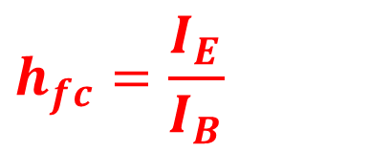
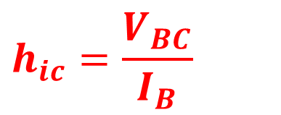
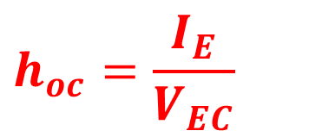
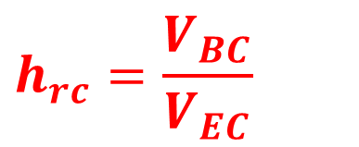
24EC2104 ELECTRONIC DEVICES & CIRCUIT DESIGN
h – Parameter Model for Common Collector:
$$h_{ic}=\frac{V_{BC}}{I_{B}}$$
V_{EC} = 0.
i.e., output
Short Circuit
I_{B}
I_{E}
B
Transistor
E
+
+
$$h_{rc}=\frac{V_{BC}}{V_{EC}}$$
I_{B} = 0.
i.e., input
Open Circuit
V_{BC}
V_{EC}
-
-
$$h_{fc}=\frac{I_{E}}{I_{B}}$$
C
V_{EC} = 0.
i.e., output
Short Circuit
C
Dependent Variables:
V_{BC} , I_{E}
V_{BC} = h_{ic} I_{B} + h_{rc} V_{EC}
I_{E} = h_{fc} I_{B} + h_{oc} V_{EC}
$$h_{oc}=\frac{I_{E}}{V_{EC}}$$
I_{B} = 0.
i.e., input
Open Circuit
Independent Variables:
I_{B} , V_{EC}

Slide 27
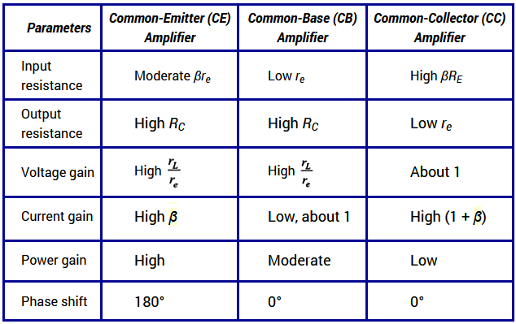
24EC2104 ELECTRONIC DEVICES & CIRCUIT DESIGN

Slide 28
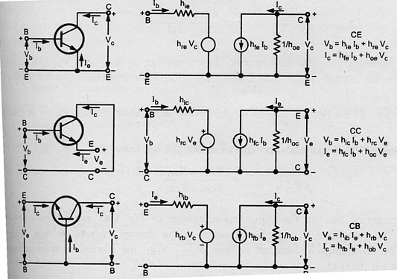
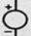
24EC2104 ELECTRONIC DEVICES & CIRCUIT DESIGN

Slide 29
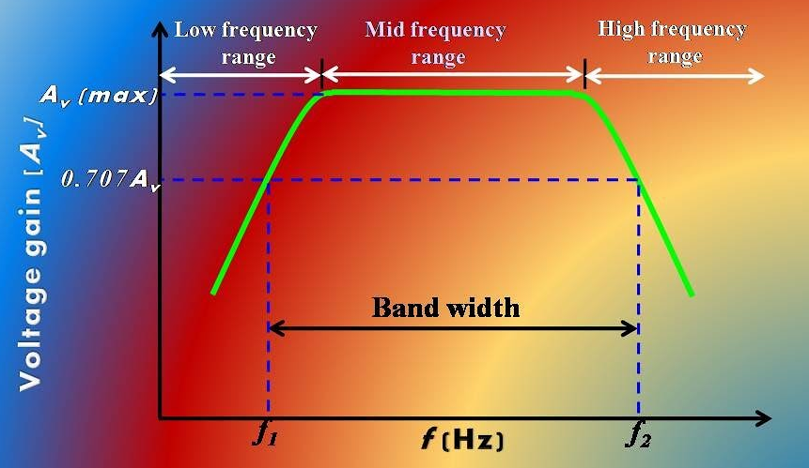
24EC2104 ELECTRONIC DEVICES & CIRCUIT DESIGN

Slide 30
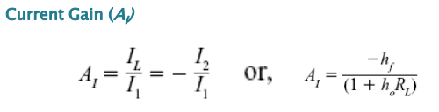
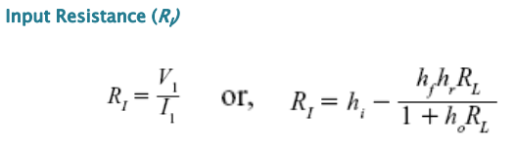
24EC2104 ELECTRONIC DEVICES & CIRCUIT DESIGN

Slide 31
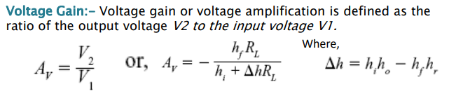
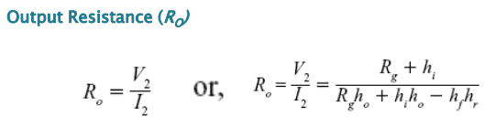
24EC2104 ELECTRONIC DEVICES & CIRCUIT DESIGN

Slide 32
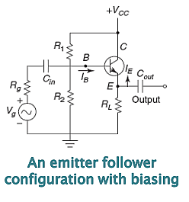
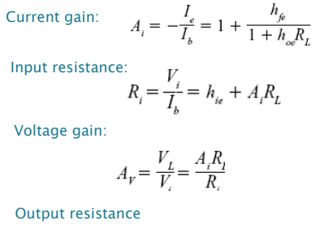
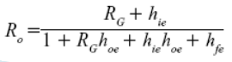
24EC2104 ELECTRONIC DEVICES & CIRCUIT DESIGN
Emitter Follower:
The emitter follower transistor is a design
which is basically a CC amplifier.
The emitter follower is used
for impedance matching.

Slide 33
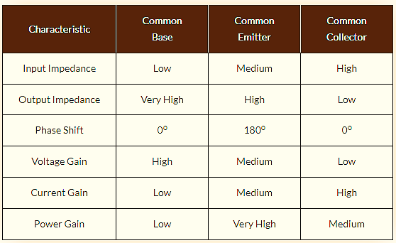
24EC2104 ELECTRONIC DEVICES & CIRCUIT DESIGN

Slide 34
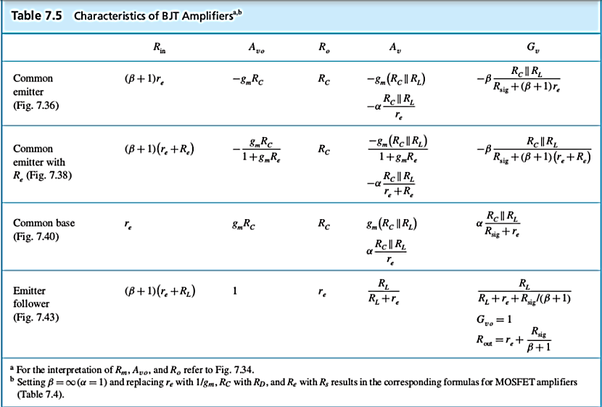
24EC2104 ELECTRONIC DEVICES & CIRCUIT DESIGN
https://engineering.purdue.edu/wcchew/ece255s18/ece%20255%20s18%20latex%20pdf%20files/ece255Lecture_13_Feb27_BJT_Basic_Config.pdf

Slide 35
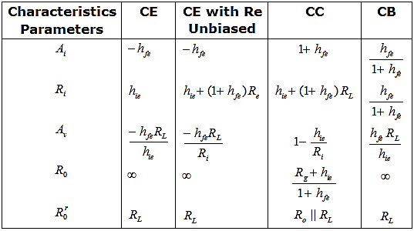
24EC2104 ELECTRONIC DEVICES & CIRCUIT DESIGN

Slide 36


24EC2104 ELECTRONIC DEVICES & CIRCUIT DESIGN
Example:
Solution:

Slide 37

24EC2104 ELECTRONIC DEVICES & CIRCUIT DESIGN
Input Impedance:

Slide 38

24EC2104 ELECTRONIC DEVICES & CIRCUIT DESIGN
Output Impedance:

Slide 39

24EC2104 ELECTRONIC DEVICES & CIRCUIT DESIGN

Slide 40

24EC2104 ELECTRONIC DEVICES & CIRCUIT DESIGN

Slide 41

24EC2104 ELECTRONIC DEVICES & CIRCUIT DESIGN

Slide 42
24EC2104 ELECTRONIC DEVICES & CIRCUIT DESIGN
Designing of CE Amplifier:
Design a CE amplifier with A_{V}= -100,
I_{C}=2mA, I_{c(min)}=1.75mA; I_{C(max)}=2.25mA,
V_{CC} =10V, R_{L} =10KΩ, f_{L} = 100Hz.
For BC107B h_{fe(min)} =180; h_{fe(max)} = 460

Slide 43

24EC2104 ELECTRONIC DEVICES & CIRCUIT DESIGN
Design Equations:
At room temperature
V_{T}=26mV

Slide 44




24EC2104 ELECTRONIC DEVICES & CIRCUIT DESIGN
Using this data, we can calculate R_{C} then R_{L}.
Select V_{CE} = 0.5V_{CC}

Slide 45







24EC2104 ELECTRONIC DEVICES & CIRCUIT DESIGN
Now calculate R_{B} using

Slide 46







24EC2104 ELECTRONIC DEVICES & CIRCUIT DESIGN
From the input loop equation
Design of Capacitors
If the lower cut-off frequency is f_{L} and the upper cut-off frequency is f_{H}, then the value of the emitter bypass capacitor C₂ can be calculated from

Slide 47




24EC2104 ELECTRONIC DEVICES & CIRCUIT DESIGN
The coupling capacitor C₁ can be calculated from
The value of the coupling capacitor C₂ can be calculated from

